Slide 1
Chapter 1
Supervision: Tradition and Contemporary Trends
© McGraw-Hill Education. All rights reserved. Authorized only for instructor use in the classroom. No reproduction or further distribution permitted without the prior written consent of McGraw-Hill Education.

Slide 2
Learning Objectives, 1
Define what a supervisor is
Summarize research findings that have led to basic ideas of what managers should do
Describe the basic types of supervisory skills
Describe how the growing diversity of the workforce affects the supervisor's role
Notes:
See text page: 2

Slide 3
Learning Objectives, 2
Identify the general functions of a supervisor
Explain how supervisors are responsible to higher management, employees, and co-workers
Describe the typical background of someone who is promoted to supervisor
Identify characteristics of a successful supervisor
Notes:
See text page: 2

Slide 4
Supervision
Supervisor: Manager at the first level of management
Ensures that the employees in a particular department are performing their jobs so that the department will contribute its share to accomplishing the organization’s goals
For the top executives of an organization, managing is ensuring that the organization’s goals will be met through its vision and business strategy
Notes:
The Taft-Hartley Act embellishes the definition for supervisor by indicating that a supervisor is “any individual having authority, in the interest of the employer, to hire, transfer, suspend, lay off, recall, promote, discharge, assign, reward or discipline other employees, or responsibility to direct them, or to adjust their grievances, or effectively to recommend such action, if in connection with the foregoing the exercise of such authority is not of a merely routine or clerical nature, but requires the use of independent judgment.”

Slide 5
Frederick Taylor
Father of scientific management
Believed that finding the best way in which a job could be completed is important for improving efficiency
Found that it was feasible to maximize efficiency by applying scientific knowledge to the study of production

Slide 6
Henri Fayol’s Views on the Functions of a Supervisor
Planning
Organizing
Leading
Controlling

Slide 7
Focus on People
Supervisors emphasize a people orientation
Deal directly with employees and have knowledge about an organization’s customers
Abraham Maslow recognized that people have different sets of needs that are met in a hierarchical pattern
Needs: Physiological, safety, love and belongingness, esteem, and self-actualization
Supervisors must help workers satisfy their personal needs while being productive in organizations

Slide 8
Types of Supervisory Skills, 1
Classic view of management skills
Technical skills
Specialized knowledge and expertise used to carry out particular techniques or procedures
Human relations skills
Ability to work effectively with other people
Conceptual skills
Ability to see the relation of the parts to the whole and to one another
Decision-making skills
Ability to analyze information and reach good decisions

Slide 9
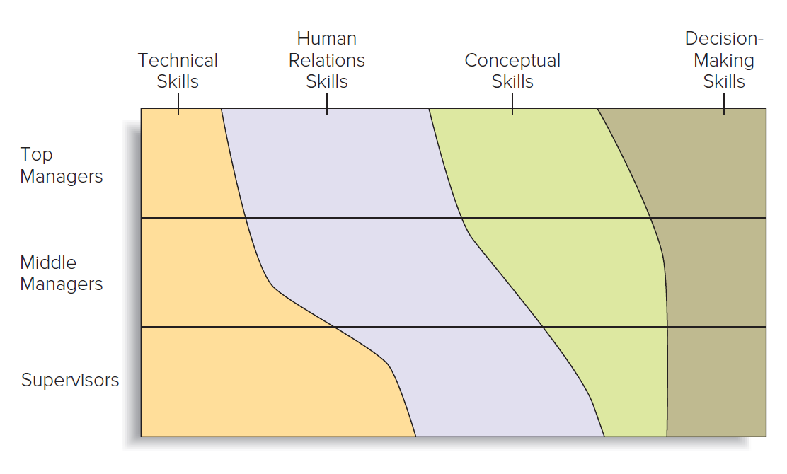
Figure 1.2: Relative Importance of Types of Skills for Different Levels of Managers
Jump to Figure 1.2: Relative Importance of Types of Skills for Different Levels of Managers, Appendix

Slide 10
Types of Supervisory Skills, 2
Modern view of management skills
Typical manager’s activities
Task-related activities: Efforts to carry out critical management-related duties
People-related activities: Efforts to manage people
Change-related activities: Efforts to modify components of the organization
Business demands such as sustainability and social media call for new ways of working
Notes:
Task-related activities: Critical management-related duties, such as planning, setting objectives for employees, and monitoring performance.
People-related activities: Efforts to manage people, such as by providing support and encouragement, recognizing contributions, developing employees’ skills, and empowering employees to solve problems.
Change-related activities: Efforts to modify components of the organization, such as monitoring the environment to detect a need for change, proposing new tactics and strategies, encouraging others to think creatively, and taking risks to promote needed changes.

Slide 11
Skills of Successful Managers
Clarifying roles
Monitoring operations
Short-term planning
Consulting
Supporting
Recognizing
Developing
Empowering
Envisioning change
Taking risks for change
Encouraging innovative thinking
External monitoring

Slide 12
Diverse Workforce
Number of Black, Hispanic, and Asian workers in the United States workforce is expected to rise
Women now make up more than 47 percent of the adult labor pool in the United States
People aged 55 years and over are expected to comprise more than 25.2 percent of the United States population by 2020
Enables supervisors to draw on a greater variety of talent and gain insights into more perspectives than ever before
Challenge: Diversity, coupled with laws and policies intended to ensure fair treatment of work groups, requires the supervisors to work successfully with a wide variety of people

Slide 13
Subtle Discrimination
Subtle forms of discrimination persist in every workplace
People hold some stereotypes that consciously or unconsciously influence their behavior
Supervisors and other managers can use several tactics to improve attitudes
Have employees work with someone who is different
Use the kind of behavior they expect employees to exhibit
Question negative stereotypes

Slide 14
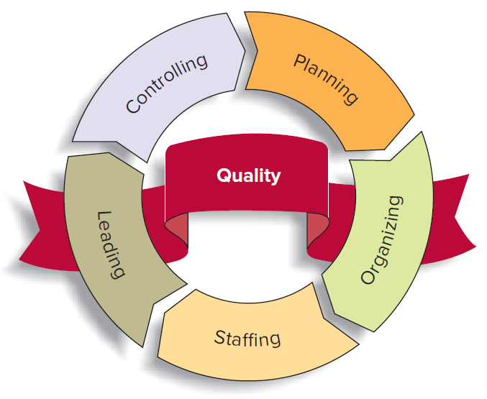
Figure 1.3: Functions of Supervisors and Other Managers
Jump to Figure 1.3: Functions of Supervisors, Appendix

Slide 15
Planning
Setting goals and determining how to meet them
Supervisors determine how their department can contribute to achieving the organization’s goals
Includes planning how much money to spend, what level of output to achieve, and how many employees will be needed

Slide 16
Organizing
Setting up a group, allocating resources, and assigning work to achieve goals
At the supervisory level, it involves activities such as scheduling projects and assigning duties to employees
Includes modern supervisors setting up and leading teams of workers to handle special projects or day-to-day operations

Slide 17
Staffing
Identifying, hiring, and developing the necessary number and quality of employees
Crucial to a supervisor’s success
Supervisor’s performance depends on the quality of results that he or she achieves through his or her employees

Slide 18
Leading
Influencing people to act, or not act, in a certain way
Supervisors:
Are responsible for letting employees know what is expected of them and inspiring and motivating them to do good work
Require good human relations skills
Need to be aware of and use behaviors that employees respond to as the supervisors desire

Slide 19
Controlling
Management function of ensuring that work goes according to plan
Monitoring performance and making needed corrections
Role of supervisors
Providing employees with the resources and motivation to identify and correct problems themselves
Utilizing the people and the equipment available in the best way possible in order to meet or exceed goals

Slide 20
Relationships Among the Functions
Order of management functions: Planning, organizing, staffing, leading, and controlling
Occurs because each function depends on the preceding function or functions
Supervisors carry out all the management functions during the course of a day
Supervisors spend most of their time leading and controlling
Higher-level managers spend more time planning and organizing

Slide 21
Responsibilities of Supervisors, 1
Recognizing the talents of each subordinate
Sharing one’s vision of where the organization wants to go
Treating employees with dignity and respect
Conducting necessary meetings efficiently and ensuring that they accomplish their intended tasks
Keeping one’s staff informed and up to date
Being accessible to those under one’s supervision
Conducting periodic evaluations of one’s group’s progress
Providing an opportunity for employees to evaluate them
Praising one’s staff for their accomplishments

Slide 22
Responsibilities of Supervisors, 2
Keeping in touch with one’s industry
Keeping a sense of humor
Being able to perform the duties of those one supervises and being fair
Following proper hiring practices, keeping accurate employee records, and knowing how to fire an employee without violating his or her rights
Knowing the law as it applies to one’s company and one’s job
Adhering to workplace safety rules and regulations
Avoiding sexual harassment and discrimination based on gender, age, race, pregnancy, sexual orientation, or national origin

Slide 23
Types of Responsibilities of Supervisors
Giving higher-level managers timely and accurate information for planning
Enabling employees to contribute to the organization’s growth
Keeping managers informed about their department’s performance
Building morale and carrying employee concerns to the relevant managers
Giving their employees clear instructions and making sure they understand their jobs
Cooperating with their co-workers in other departments

Slide 24
Responsibilities and Accountability
Supervisors are accountable for carrying out their responsibilities
Accountability is the practice of:
Imposing penalties for failing to adequately carry out responsibilities
Providing rewards for meeting responsibilities

Slide 25
Typical Candidates to be Made Supervisors
Employees with a superior grasp of the technical skills needed to perform well in a department
Employees with more seniority than other department employees
Employees with good work habits and leadership skills
Recent college graduates who demonstrate leadership potential or a specialized skill that will help in the position

Slide 26
Preparing for the Job
Learn about management through books and observation
Learn as much as possible about the organization, the department, and the job
Continue the learning process when on the job
Learn about the employees by talking to them and to one's own manager and reading performance appraisals

Slide 27
Obtaining and Using Power and Authority
Supervisors:
Can request that official announcement of the promotion be made through a meeting
Expectations, desire to work as a team, and interest in hearing about work-related problems can be stated in the meeting
Should understand how the department works and what employees expect before making changes in the department
Can build support for a change by introducing it gradually after inviting suggestions when appropriate

Slide 28
Becoming a Supervisor
Set limits on one’s behavior
Don’t be a rescuer
Figure out how to measure success
Communicate with everyone
Be firm
Learn from others
Notes:
Often, a new supervisor takes on his or her position as the result of a promotion. That means the supervisor’s relationships with others in the department will change. How do you maintain positive working relationships with people when you are now responsible for ensuring they get their work done correctly and efficiently? Here are some suggestions for making the transition smoothly:
• Set limits on your behavior. Some kinds of behavior that co-workers commonly engage in—gossiping, grumbling about work, choosing friends—will interfere with your role as supervisor. Employees are counting on you to be fair and objective. If some employees expect favors based on friendship, they are not true friends.
• Don’t be a “rescuer.” Instead of jumping in to get the work done whenever a problem arises, teach the employees in your group to do the tasks you once handled. Training can be harder than doing the job yourself, but it builds a stronger work group.
• Figure out how to measure success. How can you tell if each person is succeeding in terms of quality, cost, and timeliness? As a supervisor, you need to see when employees are on track toward meeting their goals and when you need to step in.
• Communicate with everyone. Make a point of talking to each member of your work group so that you can understand each person’s goals and everyone knows what your expectations are. Show employees how each person’s efforts benefit the whole group.
• Be firm. Sometimes employees “test” a new supervisor to see if rules and standards will be enforced. If that happens, you will need to make it clear that you are serious about the whole group’s success.
• Learn from others. Get to know other supervisors and managers who will share the wisdom gained from their experience.
Sources: Based on Brandi Britton, “Making the Move from Peer to Supervisor,” Los Angeles Business Journal, October 10, 2005; Ed Lisoski, “From Peer to Supervisor,” Supervision, May 2005, both downloaded from Business & Company Resource Center, http://galenet.galegroup.com. Lisa Quast, “8 Tips to Transition from Co-Worker to Manager,” Forbes, http://www.forbes.com/sites/lisaquast/2013/09/30/8-tips-to-transition-from-co-worker-to-manager/.

Slide 29
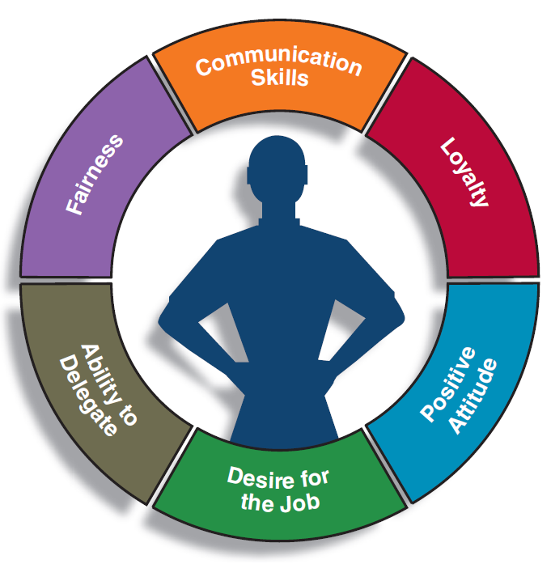
Figure 1.5: Characteristics of a Successful Supervisor
Jump to Figure 1.5: Characteristics of a Successful Supervisor, Appendix

Slide 30
APPENDICES

Slide 31
Figure 1.2: Relative Importance of Types of Skills for Different Levels of Managers, Appendix
It is divided into three horizontal sections and four vertical sections. From the top, the horizontal sections are labeled top managers, middle managers, and supervisors. From the left, the vertical sections are labeled technical skills, human relations skills, conceptual skills, and decision-making skills.
Technical skills are required most by supervisors, followed by middle managers, and are required least by top managers. Human relations skills are required most by top managers, followed by middle managers, and are required least by supervisors. Conceptual skills are required most by top managers, followed by middle managers, and are required least by supervisors. Decision-making skills are required most by top managers, followed by middle managers, and are required least by supervisors.
Jump back to Figure 1.2: Relative Importance of Types of Skills for Different Levels of Managers

Slide 32
Figure 1.3: Functions of Supervisors and Other Managers, Appendix
It has a banner that reads quality. A five-segmented circle is superimposed on the banner. Each section points to the next. Moving in a clockwise direction, the first section is labeled planning, the second section is labeled organizing, the third section is labeled staffing, the fourth section is labeled leading, and the fifth section is labeled controlling.
Jump back to Figure 1.3: Functions of Supervisors

Slide 33
Figure 1.5: Characteristics of a Successful Supervisor, Appendix
These characteristics are represented in the form of a segmented circle. The segments are labeled communication skills, loyalty, positive attitude, desire for the job, ability to delegate, and fairness. In the middle of the figure is a silhouette of a person.
Jump back to Figure 1.5: Characteristics of a Successful Supervisor

