Slide 1
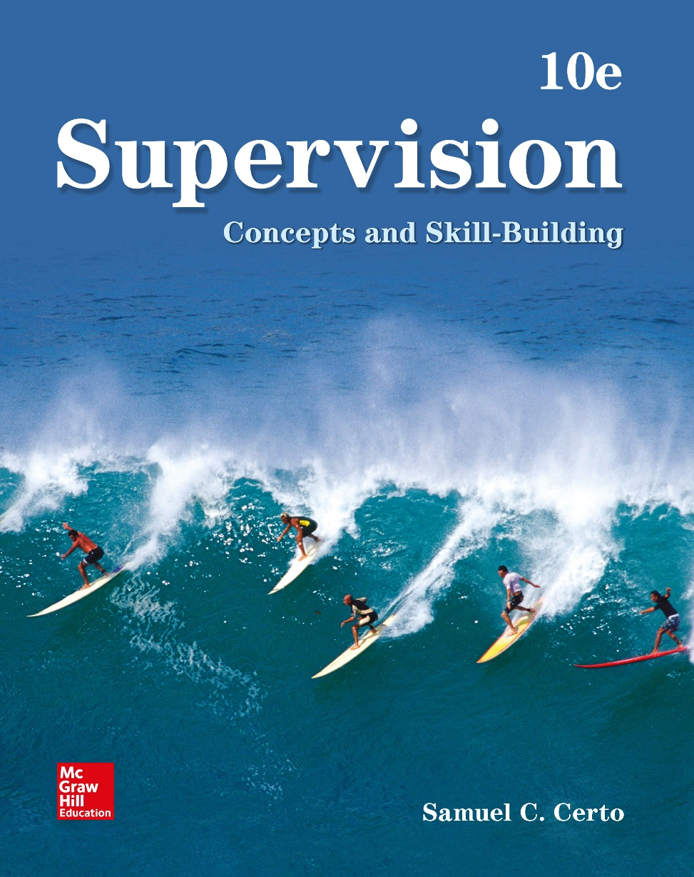
Chapter 2
The Supervisor as Leader
© McGraw-Hill Education. All rights reserved. Authorized only for instructor use in the classroom. No reproduction or further distribution permitted without the prior written consent of McGraw-Hill Education.

Slide 2
Learning Objectives
Discuss the possible link between personal traits and leadership ability
Explain democratic versus authoritarian leadership
Explain major leadership theories
Identify criteria for choosing a leadership style
Explain how supervisors can develop and maintain good relations with their employees, managers, and peers

Slide 3
Leadership
Leading: The management function of influencing people to act or not act in a certain way
Characteristics of a successful leader
Sense of responsibility
Self-confidence
High energy level
Empathy
Internal locus of control
Sense of humor
Notes:
• Sense of responsibility: A person who is promoted to a supervisory position is given responsibility for the work of others as well as for his or her own performance. Supervisors must be willing to take this responsibility seriously.
• Self-confidence: A supervisor who believes in his or her ability to get the job done will convey confidence to employees.
• High energy level: Many organizations expect supervisors to put in long hours willingly to handle the variety of duties that come with the job. Some supervisory positions also are physically challenging, requiring that the supervisor actively observe and participate in what is happening in the workplace.
• Empathy: In settling disputes, answering questions, and understanding needs, supervisors should be sensitive to the feelings of employees and higher management. Supervisors who have difficulty understanding what makes people tick will be at a disadvantage.
• Internal locus of control: An internal locus of control is the belief that you are the primary cause of what happens to yourself. People with an internal locus of control are thought to be better leaders because they try harder to take charge of events.
• Sense of humor: People with a good sense of humor are more fun to work with and work for.

Slide 4
Leadership Theories
Authoritarian leadership
Leadership style in which the leader retains a great deal of authority
Democratic leadership
Leadership style in which the leader allows subordinates to participate in decision making and problem solving
Laissez-faire leadership
Leadership style in which the leader is uninvolved and lets subordinates direct themselves
Notes:
See Learning Objective 2: Explain democratic versus authoritarian leadership.
See text page: 30

Slide 5
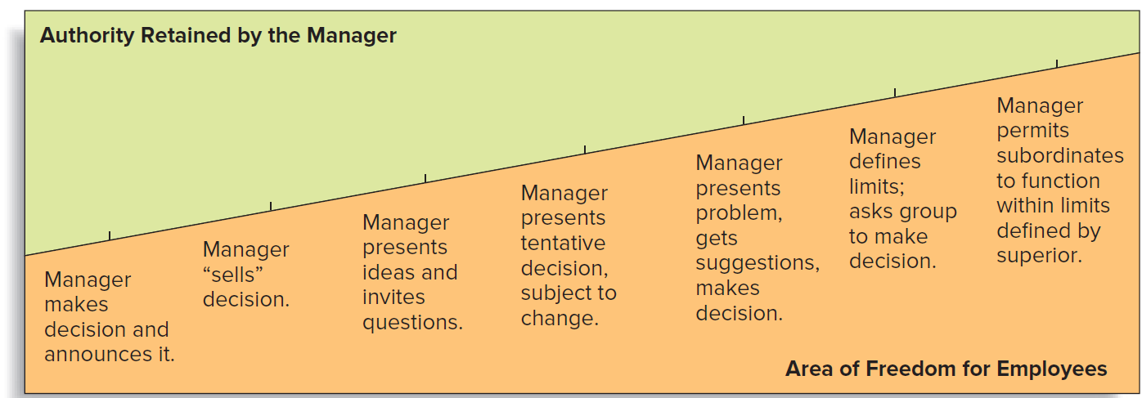
Figure 2.1: Possibilities for Retaining Authority
Source: Adapted from Robert Tannenbaum and Warren Schmidt, “How to Choose a Leadership Pattern,” Harvard Business Review, May–June 1973.
Jump to Figure 2.1: Possibilities for retaining authority, Appendix
Notes:
See Learning Objective 2: Explain democratic versus authoritarian leadership.
See text page: 30

Slide 6
The Managerial Grid
Types of leaders
Task-oriented leader: Focuses on the jobs to be done and the goals to be accomplished
People-oriented leader: Primarily concerned with the well-being of the employees being managed
Supervisors contribute to positive results when they:
Help employees see their work as meaningful
Give them resources to get the job done
Appreciate the accomplishments of the employees
Notes:
Most organizations expect their supervisors to combine some degree of task orientation with some degree of people orientation.

Slide 7
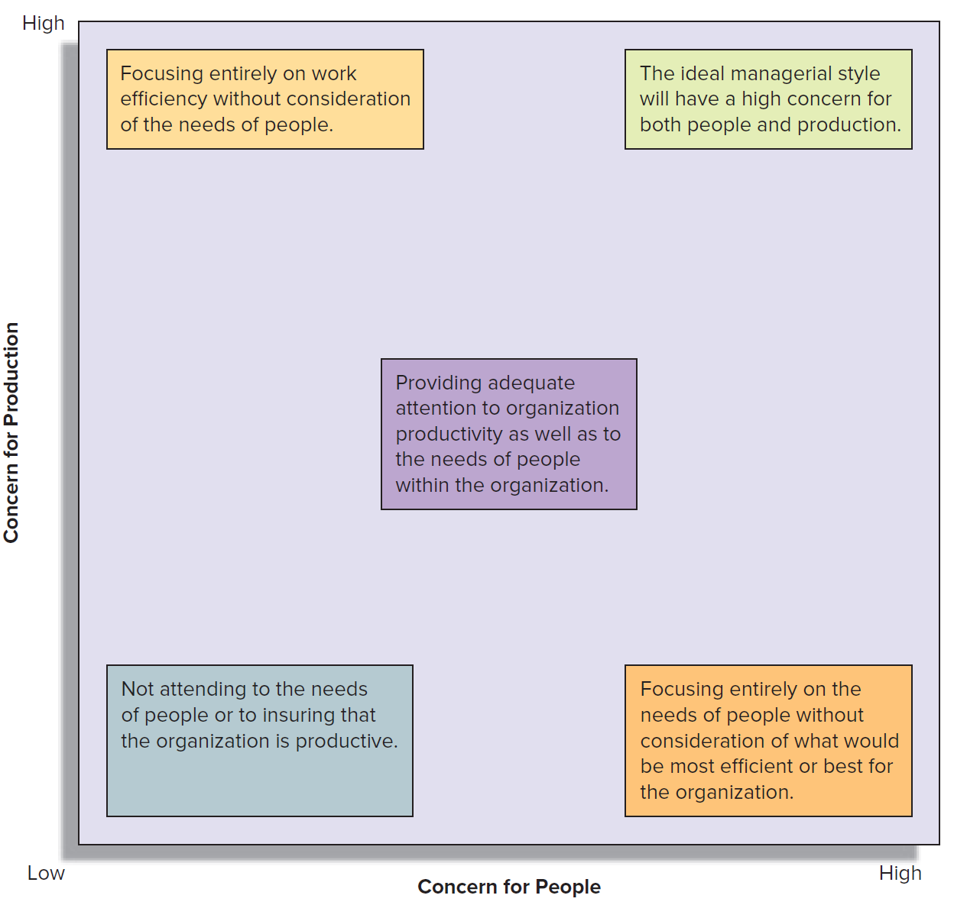
Figure 2.2: The Managerial Grid
Jump to Figure 2.2: The Managerial Grid, Appendix

Slide 8
Contingency Theories of Leadership, 1
Fiedler’s Contingency Model
Each leader has a preferred leadership style, which may be relationship oriented or task oriented
Performance depends on three characteristics of the leadership situation
Leader and member relations
Task structure
Position power of the leader
Recommends that a leader determine whether his or her preferred leadership style fits the situation
If not, the leader should try to change the characteristics of the situation
Notes:
See Learning Objective 3: Explain major leadership theories.
See text page: 31

Slide 9
Fiedler’s Contingency Model of Leadership, 1
Leader-Member Relations | Good | Good | Good | Good
Task Structure | Structured | Structured | Unstructured | Unstructured
Leader Position Power | Strong | Weak | Strong | Weak
Which Leader Performs Better? | Task-Oriented Leader | Task-Oriented Leader | Task-Oriented Leader | Relationship-Oriented Leader

Slide 10
Fiedler’s Contingency Model of Leadership, 2
Leader-Member Relations | Poor | Poor | Poor | Poor
Task Structure | Structured | Structured | Unstructured | Unstructured
Leader Position Power | Strong | Weak | Strong | Weak
Which Leader Performs Better? | Relationship-Oriented Leader | Relationship-Oriented Leader | Task- or Relationship-Oriented Leader | Task-Oriented Leader
Source: Adapted from Fred E. Fiedler, “Engineer the Job to Fit the Manager,” Harvard Business Review, September–October 1965.

Slide 11
Contingency Theories of Leadership, 2
Life cycle theory or Hersey-Blanchard theory
Assumes that the leader’s behavior should adapt to the situation
Leadership style should reflect the maturity of the followers, as measured by traits such as ability to work independently
As their followers mature, leaders should adjust the degree of task and relationship behavior in response to the growing maturity of their followers
Notes:
See Learning Objective 3: Explain major leadership theories.
See text page: 32

Slide 12
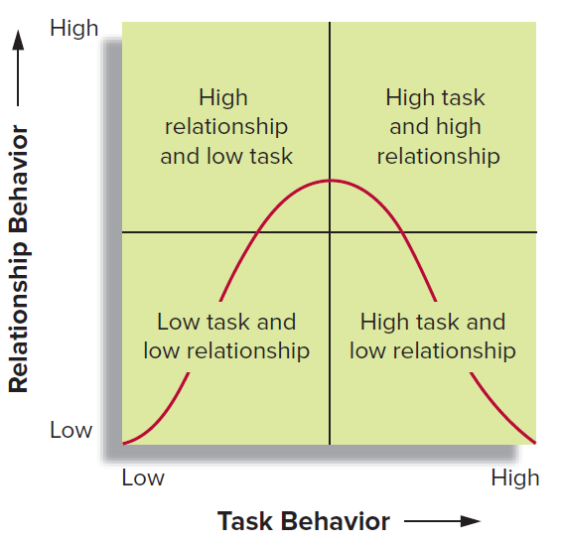
Figure 2.4: Model of the Life Cycle Theory of Leadership
Jump to Figure 2.4: Model of the Life Cycle Theory of Leadership, Appendix

Slide 13
Path-Goal Theory, 1
Primary activities of a leader are to:
Make desirable and achievable rewards available to organization members who attain organizational goals
Clarify the kinds of behavior that must be performed to earn those rewards
Leaders should exhibit the following behaviors:
Directive behavior: Telling followers what to do and how to do it
Supportive behavior: Recognizing that above all, followers are human beings

Slide 14
Path-Goal Theory, 2
Participative behavior: Seeking input from followers about methods for improving business operations
Achievement behavior: Setting a challenging goal for a follower to meet and expressing confidence that the follower can meet this challenge

Slide 15
Servant Leadership
Putting other people’s needs, aspirations, and interests above one’s own
Servant leader is:
A good listener
Empathetic
Healing
Aware
Persuasive

Slide 16
Entrepreneurial Leadership
Leaders believe that one plays a very important role at a company rather than an unimportant one
Fill the following roles:
Visionary
Problem solver
Decision maker
Risk taker
Notes:
• Visionary: An entrepreneurial leader has a clear picture of how he or she would like to see their company grow in the future.
• Problem solver: Being able to solve problems, both big and small, is an essential skill for an entrepreneurial leader.
• Decision maker: Subordinates will often lose respect for their leaders if they are unable to make decisions. Entrepreneurial leaders are capable of making decisions when necessary.
• Risk taker: Making decisions about the future often involves risk. The entrepreneurial leader is comfortable with risk-taking and views it as a necessary component of being successful in business.

Slide 17
Choosing a Leadership Style, 1
Supervisors should consider the following to identify the most effective style:
Characteristics of the leader
Manager’s values
Level of confidence in employees
Personal leadership strengths
Tolerance for ambiguity
Characteristics of the subordinates
Need for independence
Readiness to assume responsibility
Tolerance for ambiguity
Notes:
See Learning Objective 4: Identify criteria for choosing a leadership style.
See text pages: 36 to 37

Slide 18
Choosing a Leadership Style, 2
Interest in the problem to be solved
Understanding of and identification with goals
Knowledge and experience
Expectations
Characteristics of the situation
Type of organization
Effectiveness of the group
Problem or task
Time available
Notes:
See Learning Objective 4: Identify criteria for choosing a leadership style.
See text pages: 37 to 39

Slide 19
Supervisors’ Relationships with Their Employees, 1
Supervisors who are liked and respected by employees will inspire them to work harder and better
Supervisors as role models
When employees evaluate an organization, they look at supervisors’ behaviors and use those behaviors as a guide for how they should act
Supervisors should follow all the rules and regulations that cover employees
Supervisors should be ethical and impartial
Notes:
See Learning Objective 5: Explain how supervisors can develop and maintain good relations with their employees, managers, and peers.
See text page: 38

Slide 20
Supervisors’ Relationships with Their Employees, 2
Developing trust
The most important way to build trust is to engage in fair, predictable behavior
Supervisors should fulfill promises and give employees credit when they do something well
Supervisors should keep the lines of communication open
Notes:
See Learning Objective 5: Explain how supervisors can develop and maintain good relations with their employees, managers, and peers.
See text page: 41

Slide 21
Supervisors’ Relationships with Their Managers
Learn about the manager
Ask about the manager’s expectations
If a supervisor is dissatisfied, he or she should:
Consider the source of the problem
Talk to his or her manager
Hunt for another job
Notes:
See Learning Objective 5: Explain how supervisors can develop and maintain good relations with their employees, managers, and peers.
See text page: 42

Slide 22
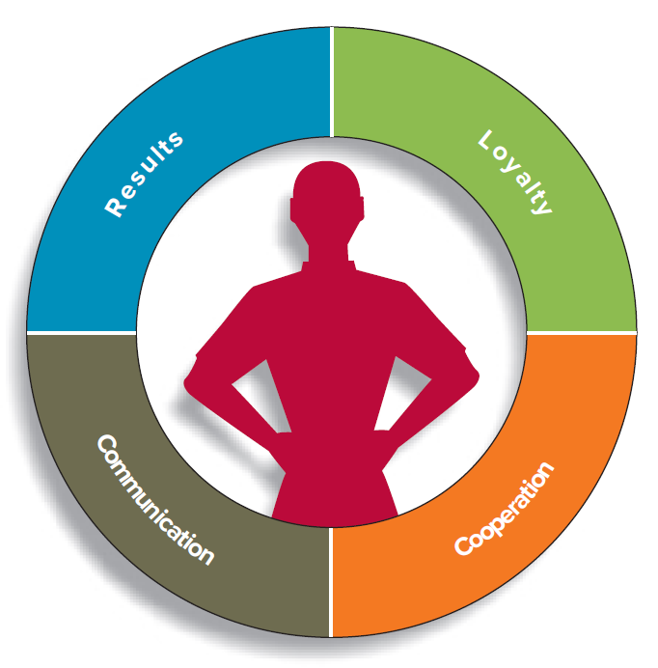
Figure 2.6: What Managers Expect of Supervisors

Slide 23
Supervisors’ Relationships with Their Peers
Competition
Should be fair and friendly
The more supervisors cooperate with peers, the better they will look
Criticism
If a co-worker must be criticized, go directly to that person and point out the problem
Focus on the problem and its consequences to the organization, not on the personalities involved

Slide 24
APPENDICES

Slide 25
Figure 2.1: Possibilities for Retaining Authority, Appendix
It is represented in the form of a rectangular box. An upward-sloping line runs across the rectangle and divides it into two unequal parts.
The upper half is labeled authority retained by the manager, and the lower half is labeled area of freedom for employees.
The diagonal line has seven markings. Starting from the left, the markings read manager makes decision and announces it; manager “sells” decision; manager presents ideas and invites questions; manager presents tentative decision, subject to change; manager presents problem, gets suggestions, makes decision; manager defines limits; asks group to make decision; and manager permits subordinates to function within limits defined by superior.
The image shows that the area of freedom for employees is inversely proportional to the authority retained by the manager.
Jump back to Figure 2.1: Possibilities for Retaining Authority

Slide 26
Figure 2.2: The Managerial Grid, Appendix
The x-axis is labeled concern for people, and the y-axis is labeled concern for production. Low concern for both people and production involves not attending to the needs of people or to insuring that the organization is productive. Low concern for people and high concern for production involve focusing entirely on work efficiency without consideration of the needs of people. High concern for people and low concern for production involve focusing entirely on the needs of people without consideration of what would be most efficient or best for the organization. High concern for people and high concern for production denote that the ideal managerial style will have a high concern for both people and production. Medium concern for both people and production involves providing adequate attention to organization productivity as well as to the needs of people within the organization.
Jump back to Figure 2.2: The Managerial Grid

Slide 27
Figure 2.4: Model of the Life Cycle Theory of Leadership, Appendix
It has a rectangle that is divided into four quadrants by a horizontal and a vertical axis. The vertical axis is labeled relationship behavior, and its values range from low to high. The horizontal axis is labeled task behavior, and its values range from low to high. The top-left quadrant is labeled high relationship and low task, the top-right quadrant is labeled high task and high relationship, the bottom-right quadrant is labeled high task and low relationship, and the bottom-left quadrant is labeled low task and low relationship. A bell-shaped curve begins at the point where the values on both the vertical and the horizontal axes are low. The values increase gradually to a point that is a little above the point of intersection of the axes and then decrease gradually to reach a point where the value on the horizontal axis is high and the value on the vertical axis is low.
Jump back to Figure 2.4: Model of the Life Cycle Theory of Leadership

